Slide 1
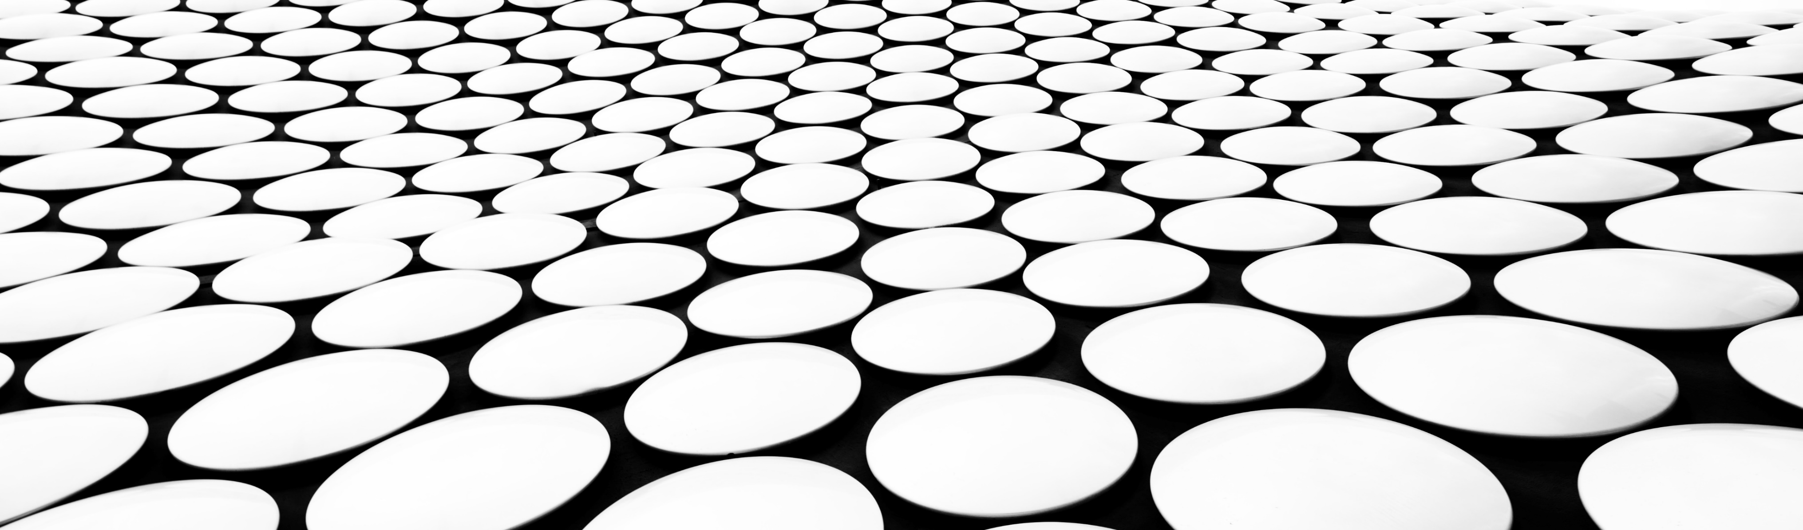
POLLUTION
TYPES OF POLLUTION

Slide 2
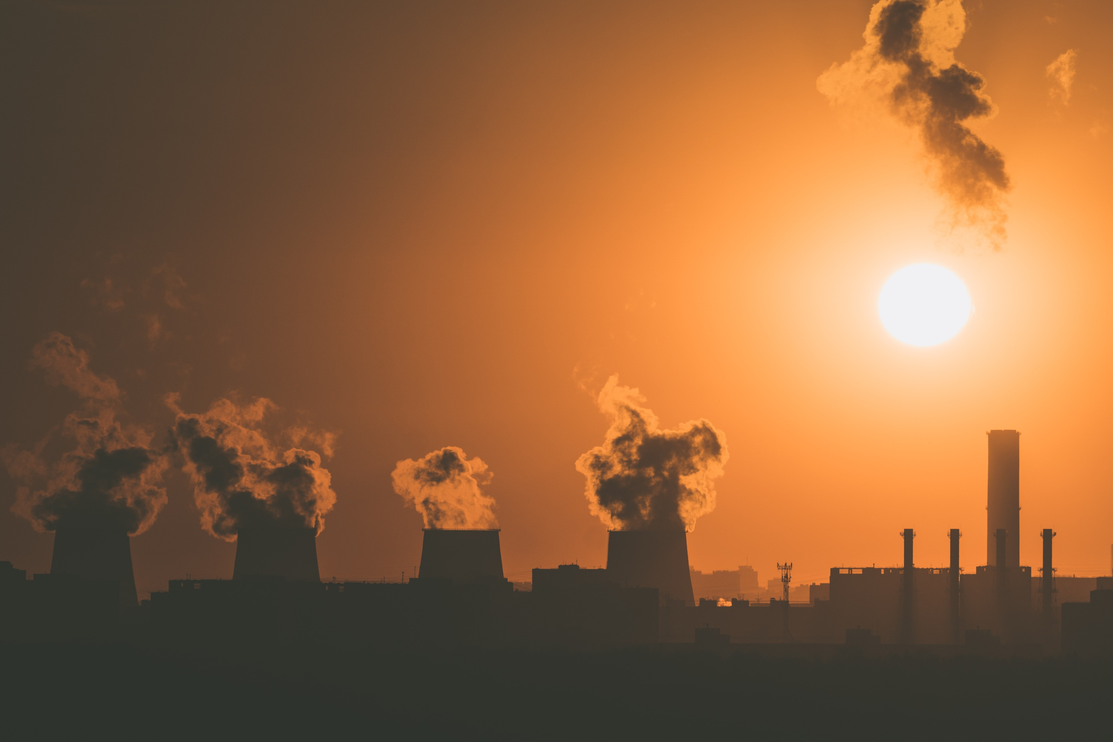
1.POLLUTION
Pollution is the introduction of contaminants into the natural environment that cause adverse change. Pollution can take the form of any substance or energy. Pollutants, the components of pollution, can be either foreign substances/energies or naturally occurring contaminants.

Slide 3
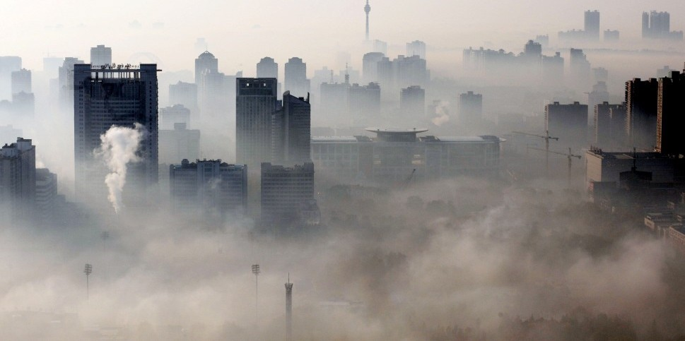
2.AIR POLLUTION
Air pollution is the contamination of air due to the presence of substances called pollutants in the atmosphere that are harmful to the health of humans and other living beings, or cause damage to the climate or to materials.

Slide 4
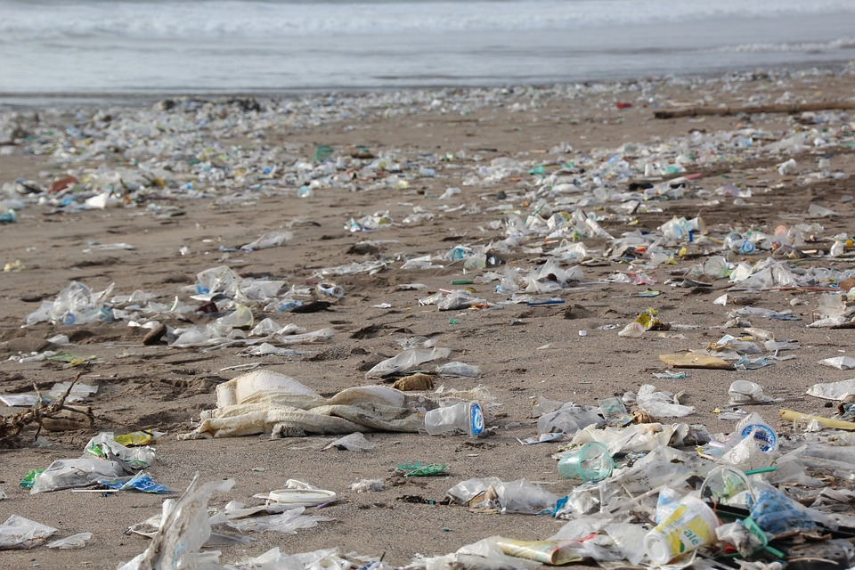
3.SOIL POLLUTION
Soil contamination, soil pollution, or land pollution as a part of land degradation is caused by the presence of xenobiotic chemicals or other alteration in the natural soil environment. It is typically caused by industrial activity, agricultural chemicals or improper disposal of waste.

Slide 5
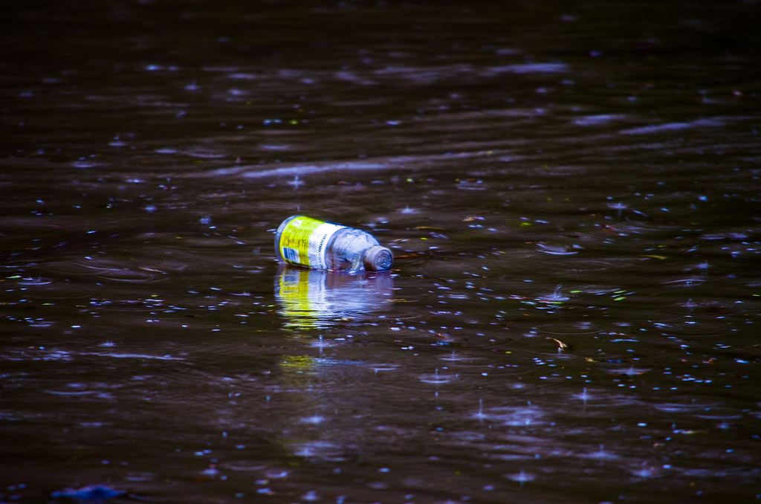
4.WATER POLLUTION
Water pollution is the contamination of water bodies, with a negative impact on their uses. It is usually a result of human activities. Water bodies include lakes, rivers, oceans, aquifers, reservoirs and groundwater. Water pollution results when contaminants mix with these water bodies.

Slide 6
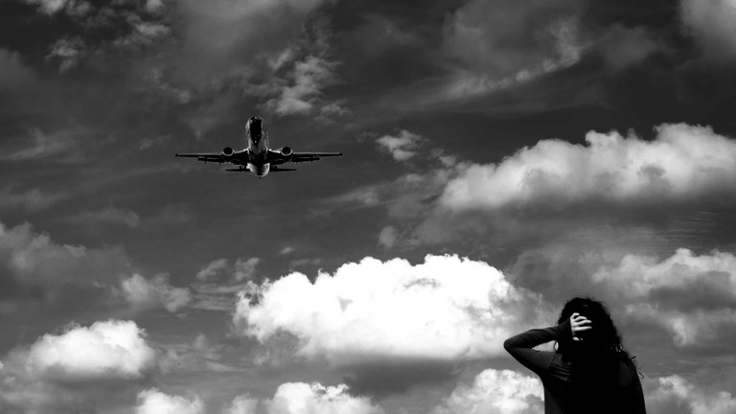
5.NOISE POLLUTION
Noise pollution, or sound pollution, is the propagation of noise or sound with ranging impacts on the activity of human or animal life, most of which are harmful to a degree. The source of outdoor noise worldwide is mainly caused by machines, transport and propagation systems.

Slide 7
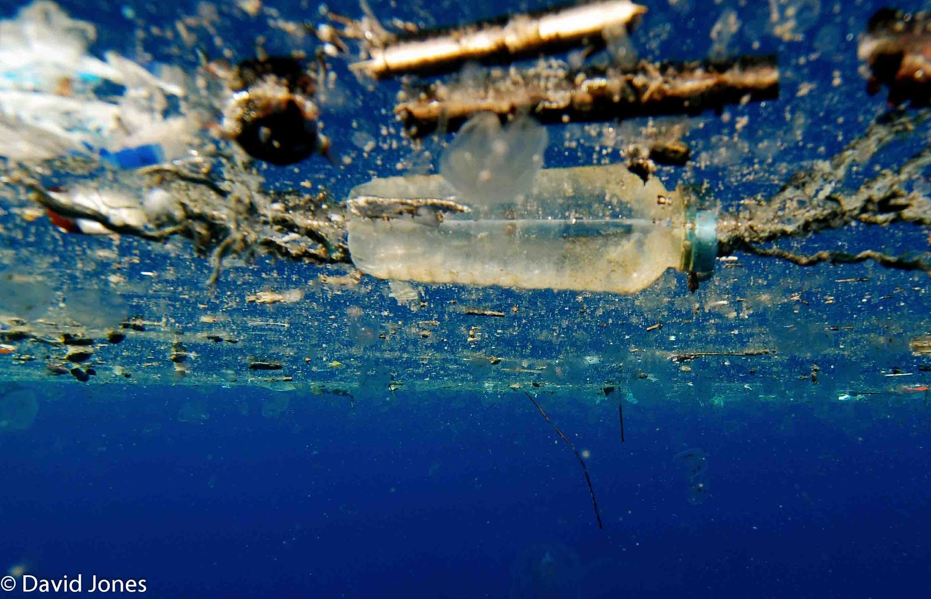
6.PLASTIC POLLUTION
Plastic pollution Plastic pollution is the accumulation of plastic objects and particles in the Earth's environment that adversely affects humans, wildlife and their habitat. Plastics that act as pollutants are categorized by size into micro-, meso-, or macro debris.

Slide 8
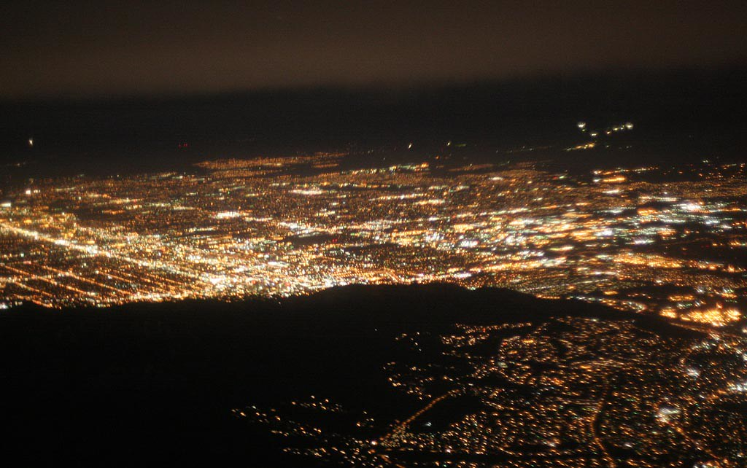
7.LIGHT POLLUTION
Light pollution is the presence of any unwanted, inappropriate, or excessive artificial lighting. In a descriptive sense, the term light pollution refers to the effects of any poorly implemented lighting sources, during the day or night.

Slide 9
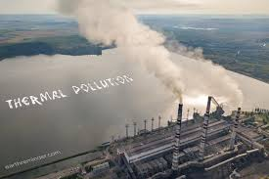
8.THERMAL POLLUTION
Light pollution is the presence of any unwanted, inappropriate, or excessive artificial lighting. In a descriptive sense, the term light pollution refers to the effects of any poorly implemented lighting sources, during the day or night.

